Slide 1
Fog of War
Ferran Martín Vilà

Slide 2
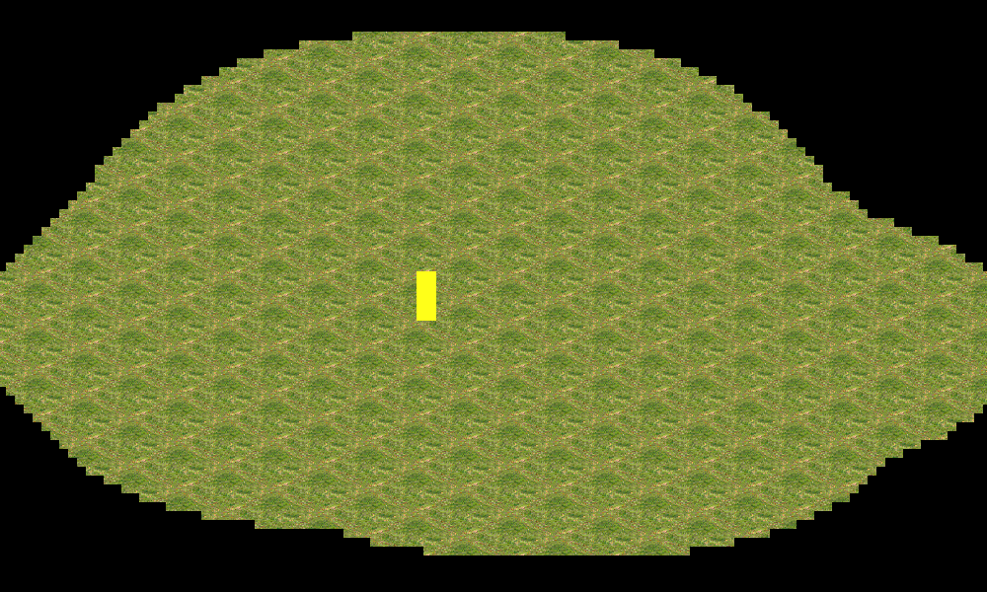
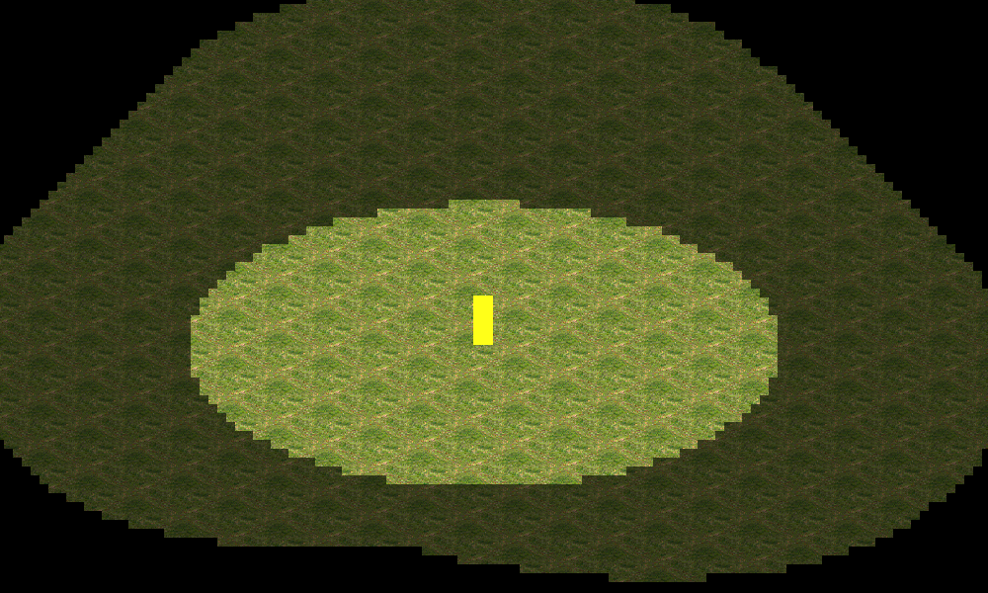
Todo 7
- Update alpha layer!

Slide 3

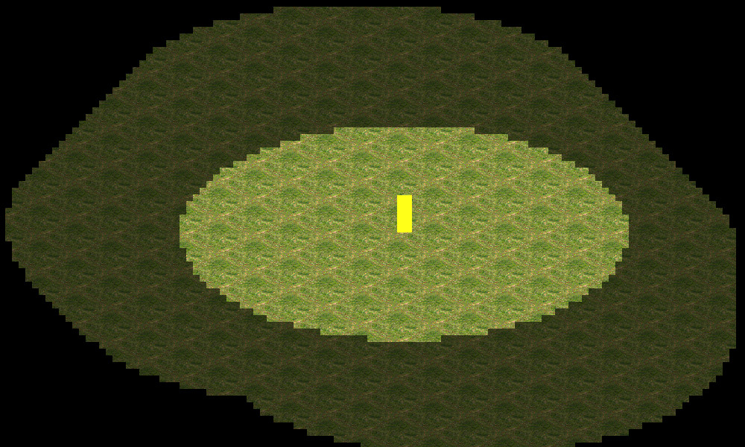
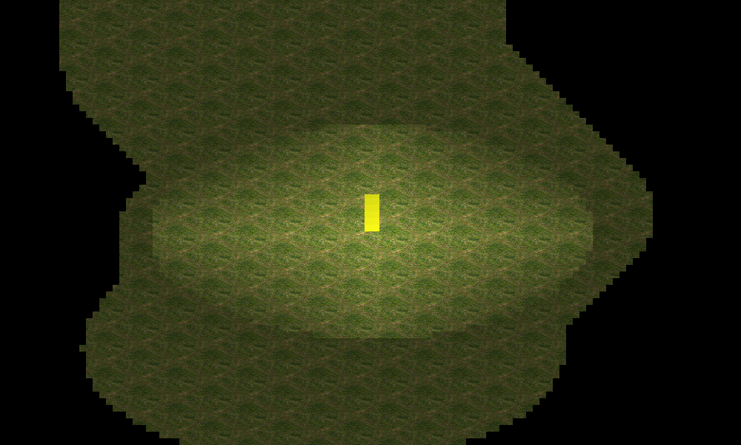
Extra Work!
- Create a function to smooth the fog alpha layer and iterate it!

Slide 4
More Info…

Slide 5

And thats it!
Contact me!
GitHub: https://github.com/ferranmartinvila
Gmail: ferranmartinvila21@gmail.com

